Slide 1

BANK HANDLOWY W WARSZAWIE S.A. 1Q 2010 consolidated financial results

Slide 2
Significant increase of net profit in 1Q 2010
Net profit in quarters (PLN MM)
227%
49%
Revenue increase:
net fee and commission income improvement
+20% YOY, PLN +25 MM
treasury result improvement
+33% YOY, PLN +19 MM
Expenses decrease
by 13% YOY (PLN 49 MM)
Cost of credit risk decrease
Net impairment losses down by
PLN 75 MM
Ratios improvement:
C/I to the level of 54% from 63%
ROE to the level of 11% from 9%
ROA to the level of 1.6% from 1.1%
Dividend recommendation

Slide 3
Net income 1Q 2010 vs. 1Q 2009
/PLN MM/
5%
(1Q10/1Q09)
Net interest income
20%
(1Q10/1Q09)
Net fee & commission income
19 MM
(1Q10/1Q09)
Treasury
13%
(1Q10/1Q09)
Expenses & depreciation
75 MM
(1Q10/1Q09)
Net impairment losses
Notes:
3

Slide 4
Net income 1Q 2010 vs. 4Q 2009
/PLN MM/
5%
(1Q10/4Q09)
Net interest income
1%
(1Q10/4Q09)
Net fee & commission income
23 MM
(1Q10/4Q09)
Treasury
1 MM
(1Q10/4Q09)
Expenses & depreciation
80 MM
(1Q10/4Q09)
Net impairment losses
Notes:
4

Slide 5
Increasing interest margin
Net interest income and net interest margin
15%
(1Q10/1Q09)
Loans income – non-financial sector
7%
(1Q10/4Q09)
Debt securities portfolio income
4%
(1Q10/4Q09)
Deposits cost – non-financial sector
/PLN MM/
Net interest margin = sum of net interest results from 4 quarters to average assets from 4 quarters

Slide 6
Volumes of retail banking
Loan volumes are financed from retail deposits
Retail loans
Retail deposits
/PLN B/
sector 1%
/PLN B/
sector 2%
5.6
(2%)
5.5
6.3
(218 MM)
6.1
(5%)
(3%)
current
term
Retail loans structure 31/03/10
Investment funds - net inflows in Citi Handlowy
Investment funds - net inflows on market
Mortgage loans
/PLN MM/
235
/PLN B/
3.7
Cash loans
1.7
118%
Other
58
305%
Credit cards
Notes:
6

Slide 7

Volumes of corporate banking
Corporate loans and deposits – non-financial sector
Corporate loans
Corporate deposits
/PLN B/
sector (1%)
/PLN B/
sector (5%)
14.2
(14%)
6.4
(4%)
6.1
12.2
12.2
(11%)
(19%)
current
O/N
term
Corporate loans structure 31/03/10
Stable level of average balances
SME & MME Enterprises
Global Clients
Increase of factoring turnover
Factoring: +44% YOY
sector +14%
Public Sector
third place in turnover among
banks rendering factoring services
Corporate Clients
Notes:
7

Slide 8
Stabilization of fee & commission result
Net fee & commission income
71%
(1Q10/1Q09)
Credit and payment cards
163%
(1Q10/1Q09)
Brokerage
28%
(1Q10/4Q09)
Investment and insurance products
DMBH’s share in volume of trade in shares on WSE 1Q 2010 (%)
/PLN MM
Net fee and commission income
Dom Maklerski Banku Handlowego
1%
1%
15%
4%
ING Securities
DM BZ WBK
Others
Ipopema

Slide 9
Treasury result improvement
Treasury
1Q 2009
1Q 2010
I/D (PLN MM)
59.5
78.8
19.3
Customer activity
Proprietary management
Customer activity result
Proprietary management result
FXO 9 MM
FXO 17 MM
FXO (7 MM)
FXO (0.3 MM)
FXO (259 MM)
FXO (105 MM)
Pro-forma data, scale on charts is incomparable
Notes:
Wpływ na wynik 2003 sprzedaży PKO/ Handlowy PTE 59MM PLN

Slide 10
Decrease of expenses and cost efficiency improvement
/PLN MM/
Cost discipline policy
Expenses decrease by 13% YoY
C/I ratio decrease by 9 p.p. to the level of 54%
Expenses structure in 1Q 2010
Retail banking:
Optimization in the scope of branch network, infrastructure, technology and acquisition expenses
Retail
Corporate
Corporate banking:
Lower depreciation, personnel and external services expenses
General administrative
Personnel
Depreciation
Notes:
10

Slide 11
Decrease of the cost of credit risk in 1Q 2010
Net impairment losses (excluding FX options)
1Q 2009
1Q 2010
I/D (PLN MM)
(95.7)
(78.3)
17.4
Net impairment losses
/PLN MM/
Retail banking:
High risk of credit cards and consumer loans portfolios
Retail
Corporate
Corporate banking:
Decrease of credit risk as a result of lasting recovery in the economy and stabilization of clients’ situation
Notes:
Wpływ na wynik 2003 sprzedaży PKO/ Handlowy PTE 59MM PLN

Slide 12
Positive market reaction on Bank’s solid fundamentals
+16% (31/12/09 – 30/04/10)
Announcement of the strategic directions of growth for 2010-2012
Information about dividend
Consistent dividend policy:
average dividend pay-out ratio 2001-07*: 92%, 2009E: 94%
average dividend yield 2001-07*: 3.8%, 2009E: 4.6%
Implementation of the Bank’s new Strategy for 2010-2012
* Excluding special dividend out of previous years profits, paid in 2005 (PLN 8.8 per share, DY 11.5%)

Slide 13
Bank’s strategy implementation
Clients segmentation:
Segmentation process is completed
Business model:
X-sell initiatives implementation (GCG/ICG)
Touchpoints with clients development (among others Plus, Unikasa, airports)
4 pillars of the Bank’s Strategy for 2010-2012
Quality and innovations:
Mobile banking
NPS increase (CitiPhone 46%)
Efficiency:
 | 1Q 2009 | 1Q 2010 | 2012
ROE | 9% | 11% | >20%
ROA | 1,1% | 1,6% | >2,5%
Cost / Income | 63% | 54% | <50%
Loans / Deposits | 73% | 63% | <100%

Slide 14
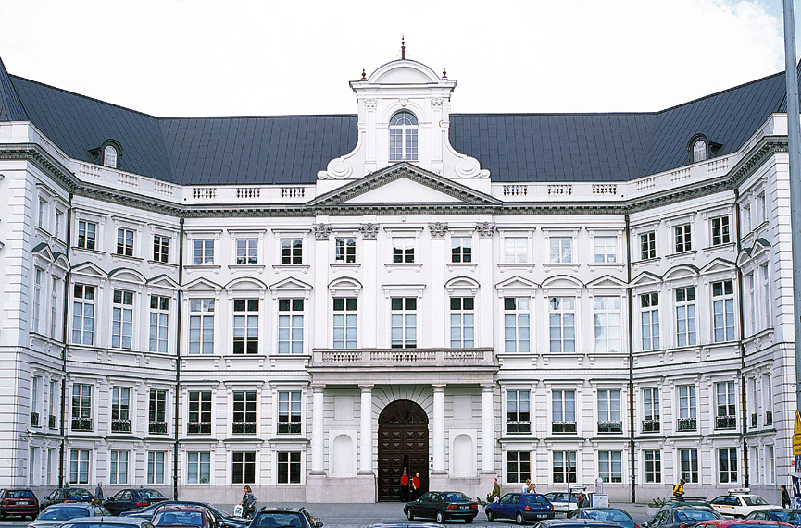
Progress in execution of the new strategy of Citi Handlowy
4 pillars of the Citi Handlowy strategy for 2010-2012:
Quality
Confidence
Innovations
Efficiency

Slide 15







Aim: access to global Citi offer
Unique team of investment banking on the market
Brokerage House of Bank Handlowy – broker number 1
DMBH’s share in volume of trade in shares on WSE in April 2010 (%)
Citi Handlowy – leader in institutional clients and enterprises service – over 350 among 500 the biggest entities in Poland are our clients
Citi investment bankers team – access to global markets and capital
18,9
Other
10,2
61,8
9,1
Source: WSE data

Slide 16

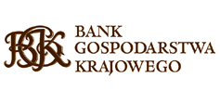

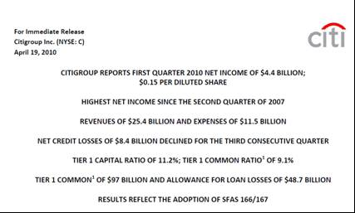




Trustworthy partner in capital gaining for institutional clients
in the country
and on the world
Transaction of the year – sale for Ministry of Treasury ‘’minor block shares” Pekao S.A. for PLN 1.1 billion
2009 - 3rd place of Citi in the ranking in terms of M&A transactions value on the world
Roads Bonds Issue – PLN 600 000 000
2010 - 3rd place of Citi in the ranking in terms of M&A transactions value on the world
One of the biggest reverse repo transaction in last 20 years – PLN 3 000 000 000
Bonds issues program for Capital Citi of Warsaw – PLN 4 000 000 000
89% value of ‘’minor block shares” of Ministry of Treasury concluded on WSE in 2009 – PLN 1 700 000 000
Municipal bonds issues for Bialystok Citi – PLN 100 000 000
Issue of Municipal Waterworks and Sewerage System in Bydgoszcz bonds – PLN 100 000 000
Notes:
1. Citi Handlowy organizatorem emisji obligacji miasta Białystok do łącznej kwoty 100 mln zł. Bank obsługuje proces przeprowadzenie emisji obligacji, pełniąc funkcję Agenta Emisji, Dealera oraz Depozytariusza.
2. Organizacja i gwarancja emisji obligacji infrastrukturalnych BGK. To największa emisji obligacji w ofercie prywatnej. Popyt na obligacje BGK wyniósł 2 mld zł.
3. Największa jednorazowa emisja publiczna obligacji niekarbowych dla miasta Warszawy na kwotę 600 mln zł.
4. Dodatkowa emisja obligacji na kwotę 100 mln zł dla Miejskich Wodociągów i Kanalizacji w Bydgoszczy.

Slide 17
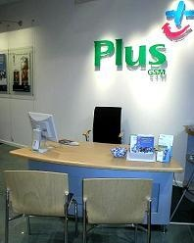

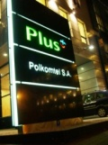
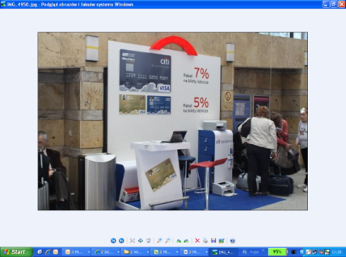

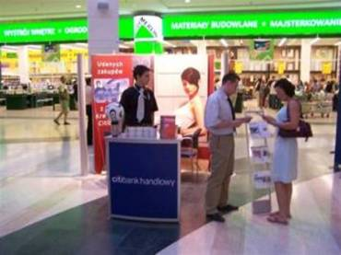
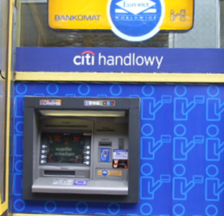
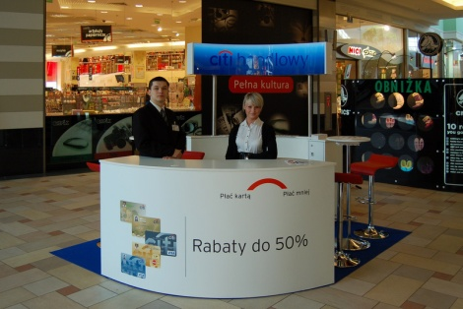
Aim: touchpoints network development in 1Q 2010
Touchpoints network with Citi Handlowy development
100 new ATMs branded with Citi Handlowy
Citibank-Plus credit card points of sale increased from 80 to 160 in Polkomtel network
Citi Handlowy with the sale of credit cards on market centers: Warsaw, Katowice, Krakow, Wroclaw, Poznan
Citi Handlowy with the sale of Citibank-LOT credit card on the airports in Warsaw, Katowice, Krakow, Wroclaw, Gdansk, Poznan

Slide 18
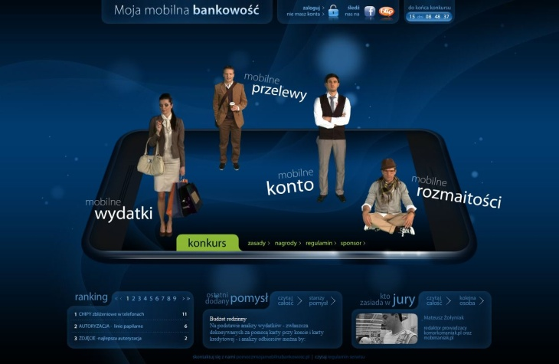
Aim: development of remote access channels
Citi Handlowy is launching mobile banking
Citi Handlowy involved fans of mobile solutions in mobile banking creation and launched internet social portal www.mojamobilnabankowosc.pl
Over 3.5 thousand registered users on the mobile banking portal
Almost 20 thousand of clicks on page www.mojamobilnabankowocc.pl
Over 460 ideas presented on www.mojamobilnabankowosc.pl
8.4 million – the number of active clients of the electronic banking (source: Polish Bank Association, December 2009)

Slide 19
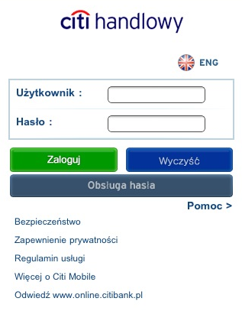

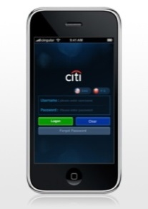
Aim: development of remote access channels
Citi Handlowy is launching mobile banking
Mobile banking
Citi Mobile
Transfers and payments may be done to all recipients added by Client to recipients list in Citibank Online
approximately by 60% each year the number of mobile and similar banking services users should grow
900 million estimated number of mobile banking users on the world in 2015
115 million Europeans should use mobile banking in 2015 (source: Berg Insight, April 2010)
CitMobile gives opportunity:
checking balances on accounts;
placements management;
payments settlement to defined country recipients at any place or time.

Slide 20
声明：
所有的版权属于原有公司，文件均来自公开渠道
此文件仅供学习使用，任何人不得进行以此为商业目的的行为
如有疑问，请立即删除
学习世界五百强和咨询公司PPT课程请访问如下网站搜索：“司马懿”
百度传课：司马懿PPT学校
https://www.chuanke.com
网易学堂：司马懿PPT学校
https://study.163.com
知乎： 司马懿PPT学校
https://www.zhiu.com

